Slide 1
23AD2001O ARTIFICIAL INTELLIGENCE & MACHINE LEARNING L T P S : 3 0 2 0
Session no: 0
Topic: Introduction to ai & ml

Slide 2
Artificial Intelligence
Artificial Intelligence (AI), refers to the development of computer systems that can perform tasks that would normally require human intelligence, such as learning, problem-solving, decision-making, and pattern recognition.
The term “artificial intelligence” was coined in the 1950s by John McCarthy.
John McCarthy is considered the father of Artificial Intelligence.

Slide 3
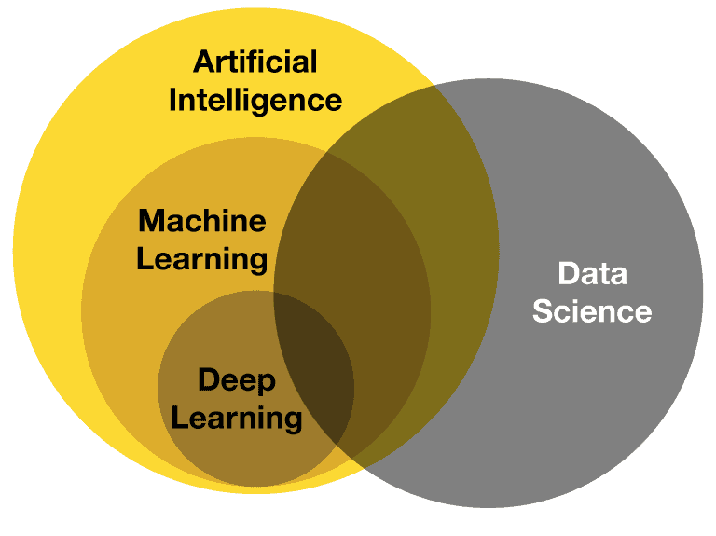
AI & ML INTRODUCTION

Slide 4
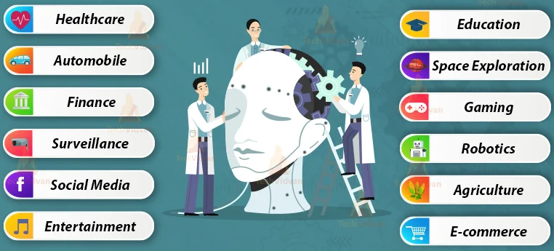
APPLICATIONS OF AI & ML

Slide 5
Artificial intelligence and machine learning - SYLLABUS
MODULE 1
Introduction to Artificial Intelligence: Overview of AI, history, and applications; Agents and Environments; Problem Solving through search: Uninformed Search Algorithms: Breadth-first search, Depth-first search, Depth Limit search, Iterative deepening search, Bi-Directional Search; Informed Search: Heuristic search, Best First Search, A* algorithm, Local Search algorithms: Hill Climbing Algorithm, Simulated Annealing, Adversarial Search: Minimax algorithm, Alpha-beta pruning

Slide 6
Artificial intelligence and machine learning - SYLLABUS
MODULE 2
Constraint Satisfaction: Problem formulation, Constraint propagation, Backtracking algorithms, Knowledge Engineering: propositional Logic, Predicate Logic, Inferencing through propositional and Predicate Logic: Introduction, Inferencing rules, Inferencing Mechanisms: Entitlement, Resolution, Lifting, Reasoning, Implementing inferencing: Forward Checking and Backward Chaining; Introduction to probability theory, Introduction to uncertainty Bayes Theorem

Slide 7
Artificial intelligence and machine learning - SYLLABUS
MODULE 3
Machine Learning: Introduction to Machine Learning, Types of Machine Learning; Introduction to Data Preprocessing: Data Cleaning, Data Splitting, Data Normalization, Data Batching, Data Shuffling, Overfitting and Underfitting; Performance metrics: Confusion matrix, Accuracy, F-score, Precession and Recall, Cross Validations; Supervised learning: Linear regression, Logistic Regression, Naive Bayes Classification, Bayesian Belief Networks; Decision Trees, KNN; Support Vector Machines (SVM), Introduction to Ensemble methods.

Slide 8
Artificial intelligence and machine learning - SYLLABUS
MODULE 4
Ensemble methods: Bagging: Random Forest, Boosting: XG Boosting, Ada-Boosting, Unsupervised learning algorithms: K-Means clustering, Hierarchical Clustering Artificial Neural Networks (ANN): Introduction to ANN: Weights and Bios, Bios Vs Variance, McCulloch Pits, Perceptron, Applications of ANN, Types of ANN: Single-Layer Perceptron, Multi-Layer Perceptron, Feedforward and Backwards ANNs, Recurring RNN, Basics of ANN: Structure of ANN, Functionality of ANN, Learning ANNs, ANN techniques: Activation functions, Error computation (Loss Functions), Error distribution(Optimization), and Prediction using ANN.

Slide 9
End Semester Summative Evaluation
EVALUTION COMPONENTS
Evaluation Type | Evaluation Component | Weightage/Marks |  | Duration (Hours) | CO1 | CO2 | CO3 | CO4 | CO5
End Sem Summetive 40% | End Semester Exam | Weightage | 25 | 180 | 6.25 | 6.25 | 6.25 | 6.25
 |  | Max Marks | 100 |  | 25 | 25 | 25 | 25
 | Lab End Semester Exam | Weightage | 15 | 180 |  |  |  |  | 15
 |  | Max Marks | 50 |  |  |  |  |  | 50

Slide 10
In Semester Formative Evaluation
Evaluation Type | Evaluation Component | Weightage/Marks |  | Duration (Hours) | CO1 | CO2 | CO3 | CO4 | CO5
In Semester Summative Evaluation Total= 28 % | Continuous Evaluation - Lab Exercise | Weightage | 8 | 120 |  |  |  |  | 8
 |  | Max Marks | 100 |  |  |  |  |  | 100
 | MOOCs Review | Weightage | 10 | 90 | 2.5 | 2.5 | 2.5 | 2.5
 |  | Max Marks | 100 |  | 25 | 25 | 25 | 25
 | ALMs | Weightage | 10 | 120 | 2.5 | 2.5 | 2.5 | 2.5
 |  | Max Marks | 100 |  | 25 | 25 | 25 | 25

Slide 11
In Semester Summative Evaluation
Evaluation Type | Evaluation Component | Weightage/Marks |  | Duration (Hours) | CO1 | CO2 | CO3 | CO4 | CO5
In Semester Summative Evaluation Total= 32 % | Semester in Exam-I | Weightage | 12 | 90 | 6 | 6
 |  | Max Marks | 50 |  | 25 | 25
 | Semester in Exam-II | Weightage | 12 | 90 |  |  | 6 | 6
 |  | Max Marks | 50 |  |  |  | 25 | 25
 | Lab In Semester Exam | Weightage | 8 | 120 |  |  |  |  | 8
 |  | Max Marks | 50 |  |  |  |  |  | 50

Slide 12
books
Text Books:
Stephen Marsland, “Machine Learning an Algorithmic Perspective”, CRC Press, (9999).
Tom M. Mitchell, “MachineLearning”, McGrawHill, 1997.
Reference Books :
1. Peter Harrington, “Machine Learning in Action”, Manning Publications
2. Ethem lpaydin, “Introduction to Machine Learning”, The MIT Press, (2010).
3. Programming Python by Mark Lutz, O'Reilly
4. Chun, J Wesley, Core Python Programming, 2 nd Edition Pearson 2007 Reprint

Slide 13
Web links
1. Data Science and Machine Learning: https://www.edx.org/course/data-science-machinelearning
2. Machine Learning:
https://www.ocw.mit.edu/courses/6-867-machine-learning-fall-2006/

Slide 14
summary:
AI and ML applications are transforming various domains, including healthcare, agriculture, robotics, automation, law, medicine, pharmacy, and business management.
The potential benefits of these applications include improved efficiency, reduced costs, and improved decision-making.
However, there are also potential risks and challenges associated with the use of AI and ML applications, including privacy concerns, bias, and the need for ethical guidelines.
It is important for researchers, policymakers, and practitioners to work together to develop responsible and ethical AI and ML applications that benefit society as a whole.

Slide 15
Self assessment questions
Which of the following is not the application of AI?
Self Driving Cars
Medical Image Diagnosis
Supermarket Order processing System
Crop yield Prediction
Which of the following are part of AI
Machine Learning
Data Warehousing
Deep Learning
Data Science

Slide 16
Terminal questions
List some applications of Machine Learning
How does ML applications differ from AI applications?
What are the advantages and disadvantages of Machine Learning?

Slide 17
Reference books and web links
Text Books:
Russel and Norvig, ‘Artificial Intelligence’, third edition, Pearson Education, PHI, (2015)
Elaine Rich & Kevin Knight, ‘Artificial Intelligence’, 3nd Edition, Tata McGraw Hill Edition, Reprint (2008)
Web links:
https://www.geeksforgeeks.org/agents-artificial-intelligence/
https://www.simplilearn.com/what-is-intelligent-agent-in-ai-types-function-article
https://www.javatpoint.com/turing-test-in-ai
https://www.geeksforgeeks.org/turing-test-artificial-intelligence/
https://www.section.io/engineering-education/turing-test-in-ai/

Slide 18
THank yoU

